Slide 1
Feedforward Control Systems
MADE BY
KRITIKA KASHYAP

Slide 2
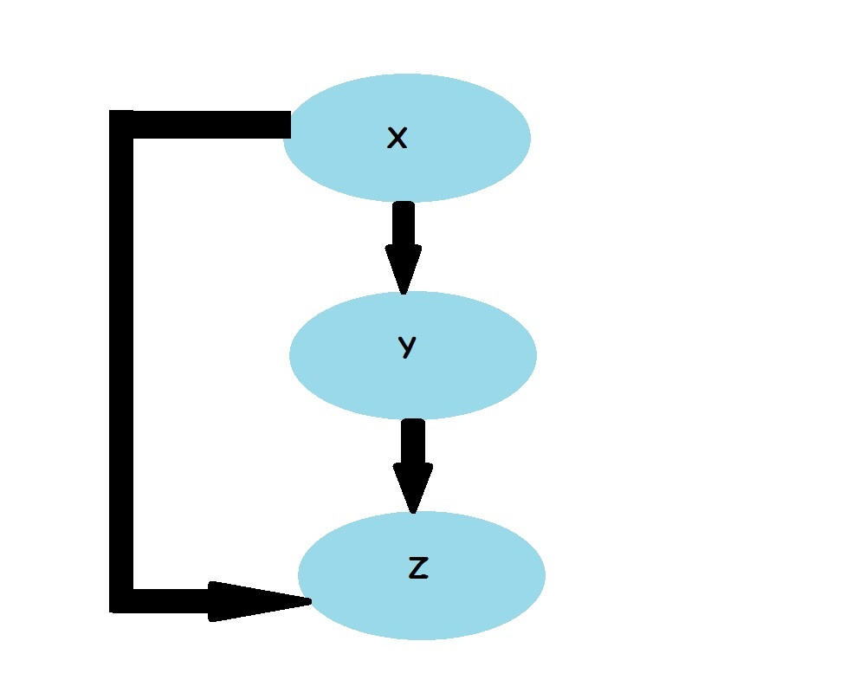
Coherent Feedforward Loop
An Introduction to Systems Biology – Uri Alon

Slide 3
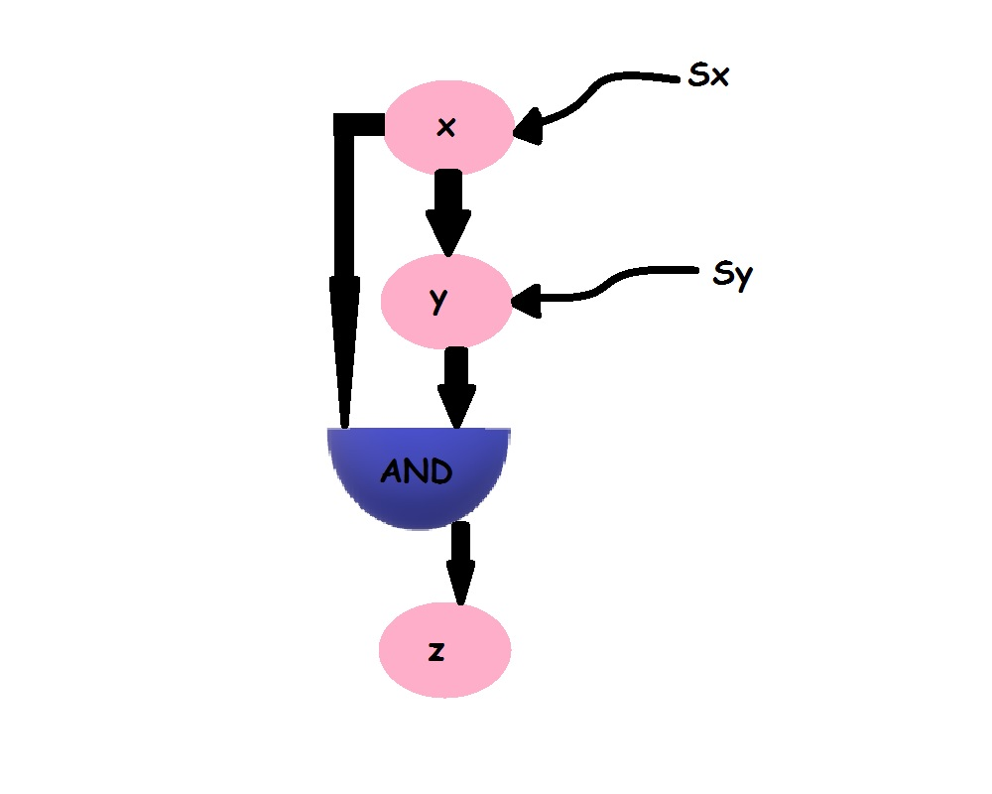
Coherent Feedforward Loop with an AND Input Function

Slide 4
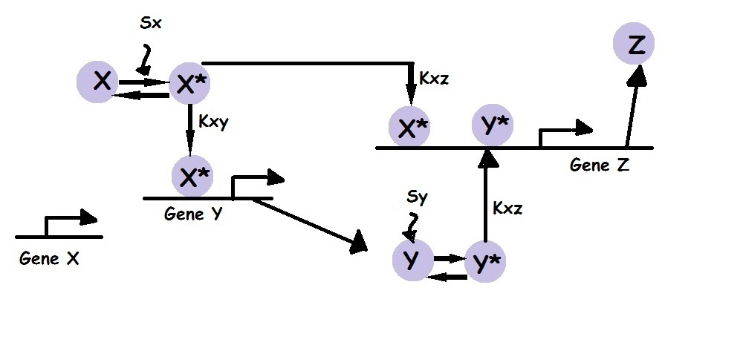
Molecular Interactions in Coherent Feedforward Loop

Slide 5
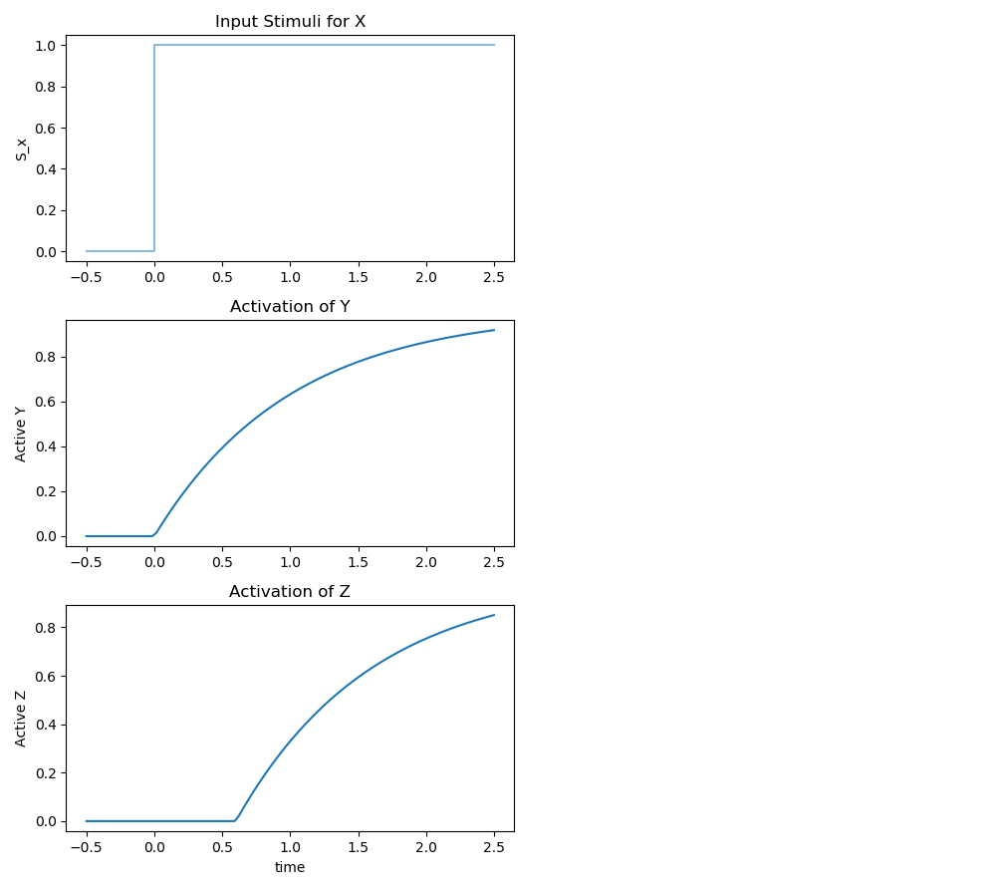

Slide 6
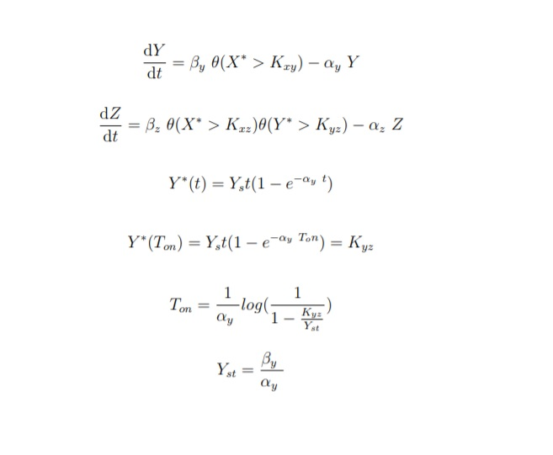
Model Equations

Slide 7
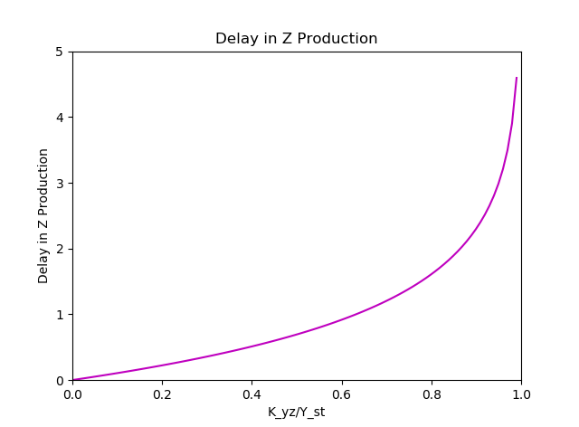

Slide 8
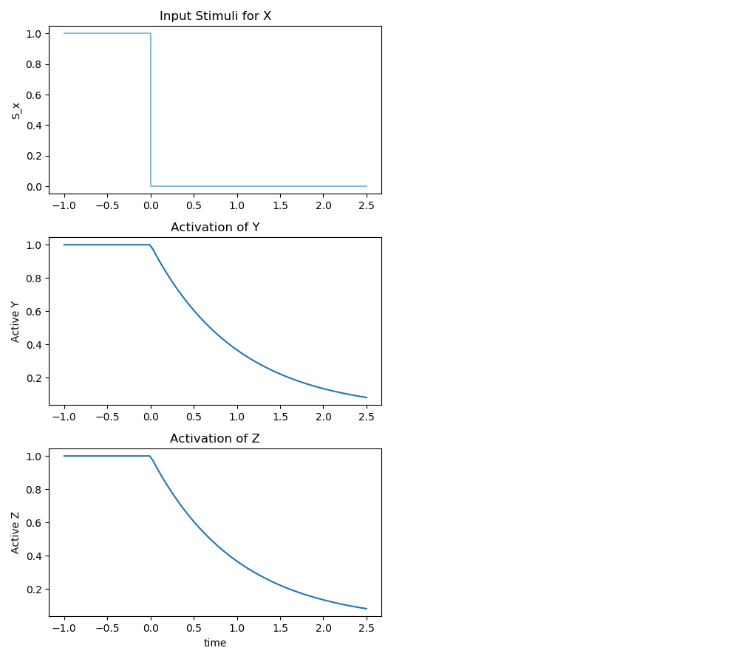

Slide 9
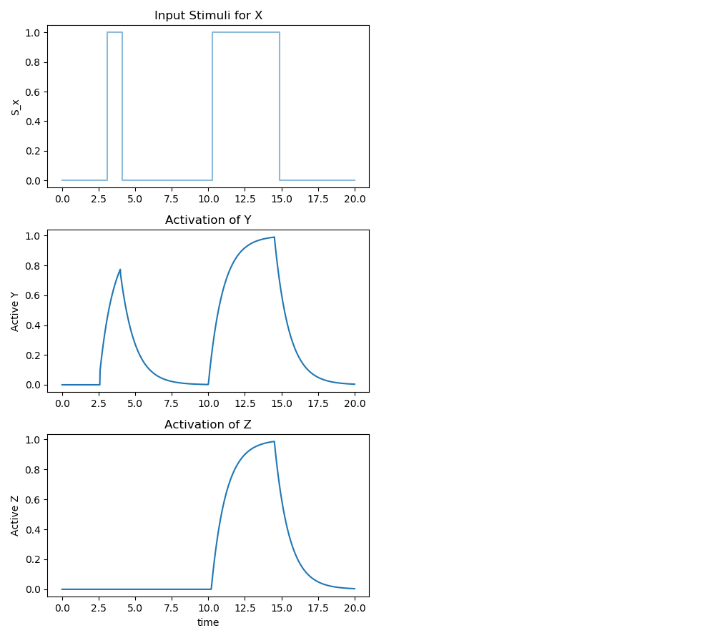

Slide 10
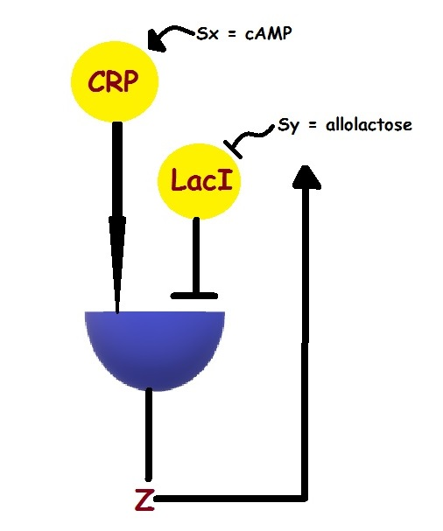
The Lac Operon

Slide 11
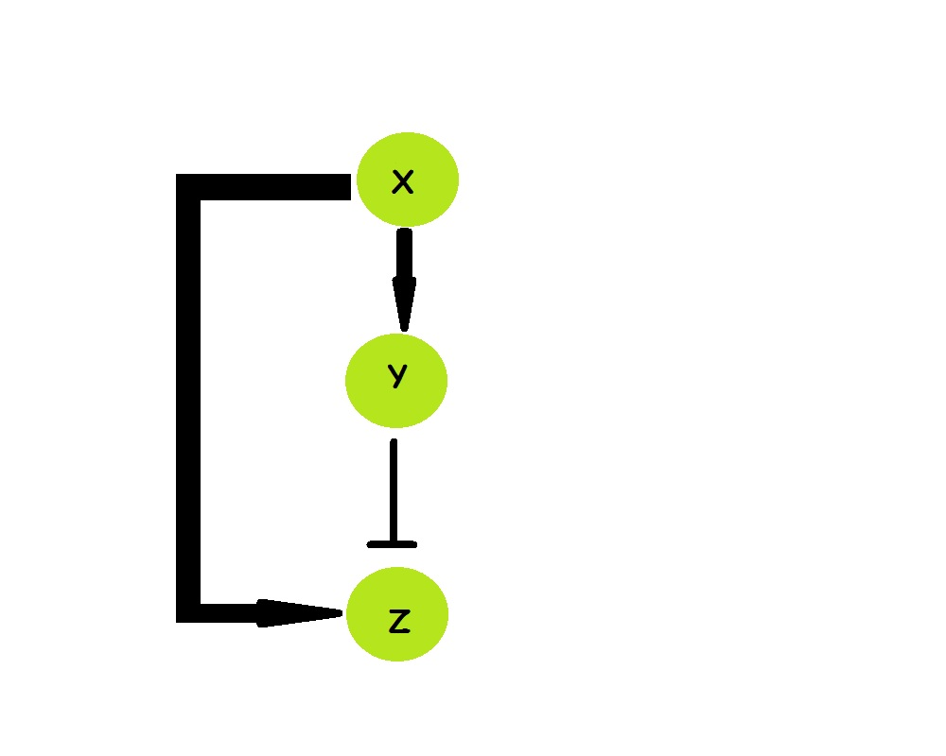
Incoherent Feedforward Loop

Slide 12
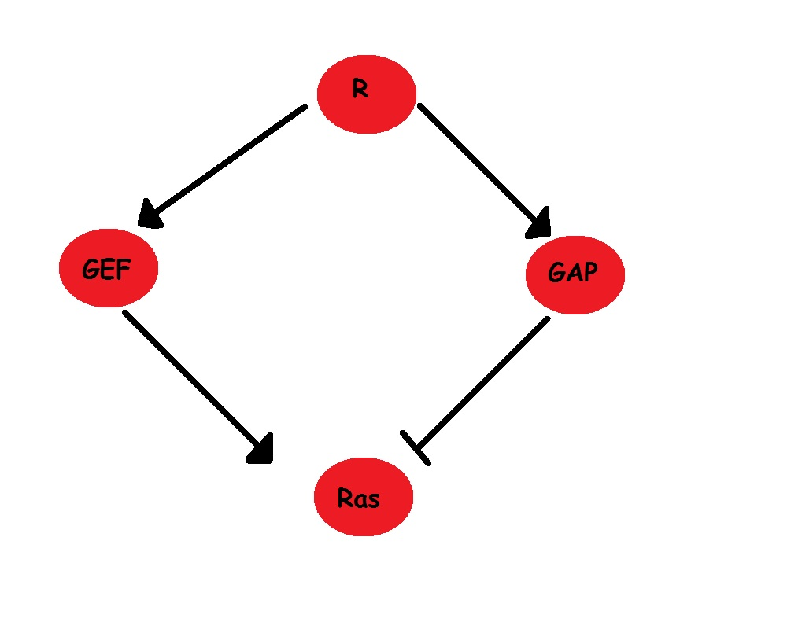
Incoherent Feedforward Control of Activated Ras
Incoherent Feedforward Control Governs Adaptation of
Activated Ras in a Eukaryotic Chemotaxis Pathway
Kosuke Takeda1, Danying Shao2, Micha Adler3, Pascale G. Charest1, William F. Loomis1,
Herbert Levine2, Alex Groisman3, Wouter-Jan Rappel2, and Richard A. Firtel1,

Slide 13
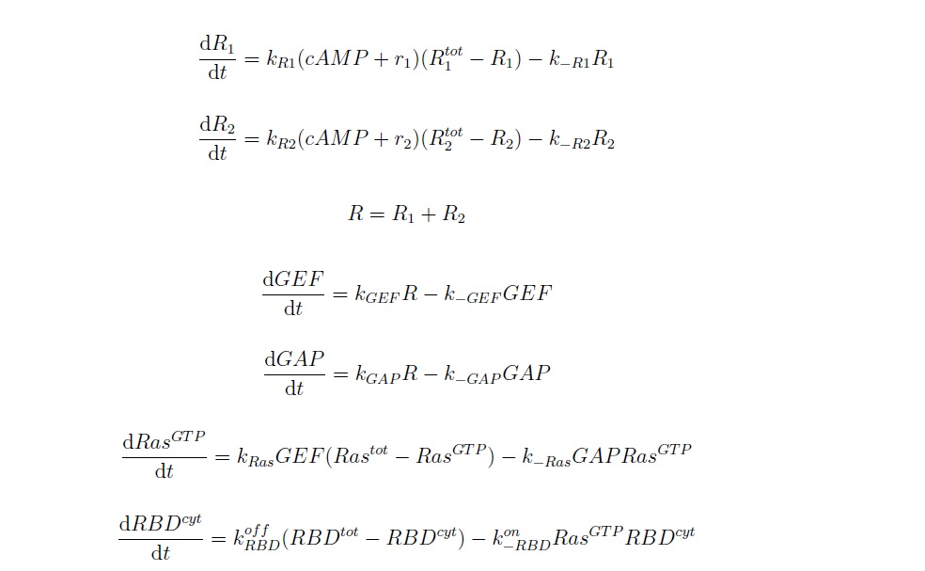
Model Equations

Slide 14
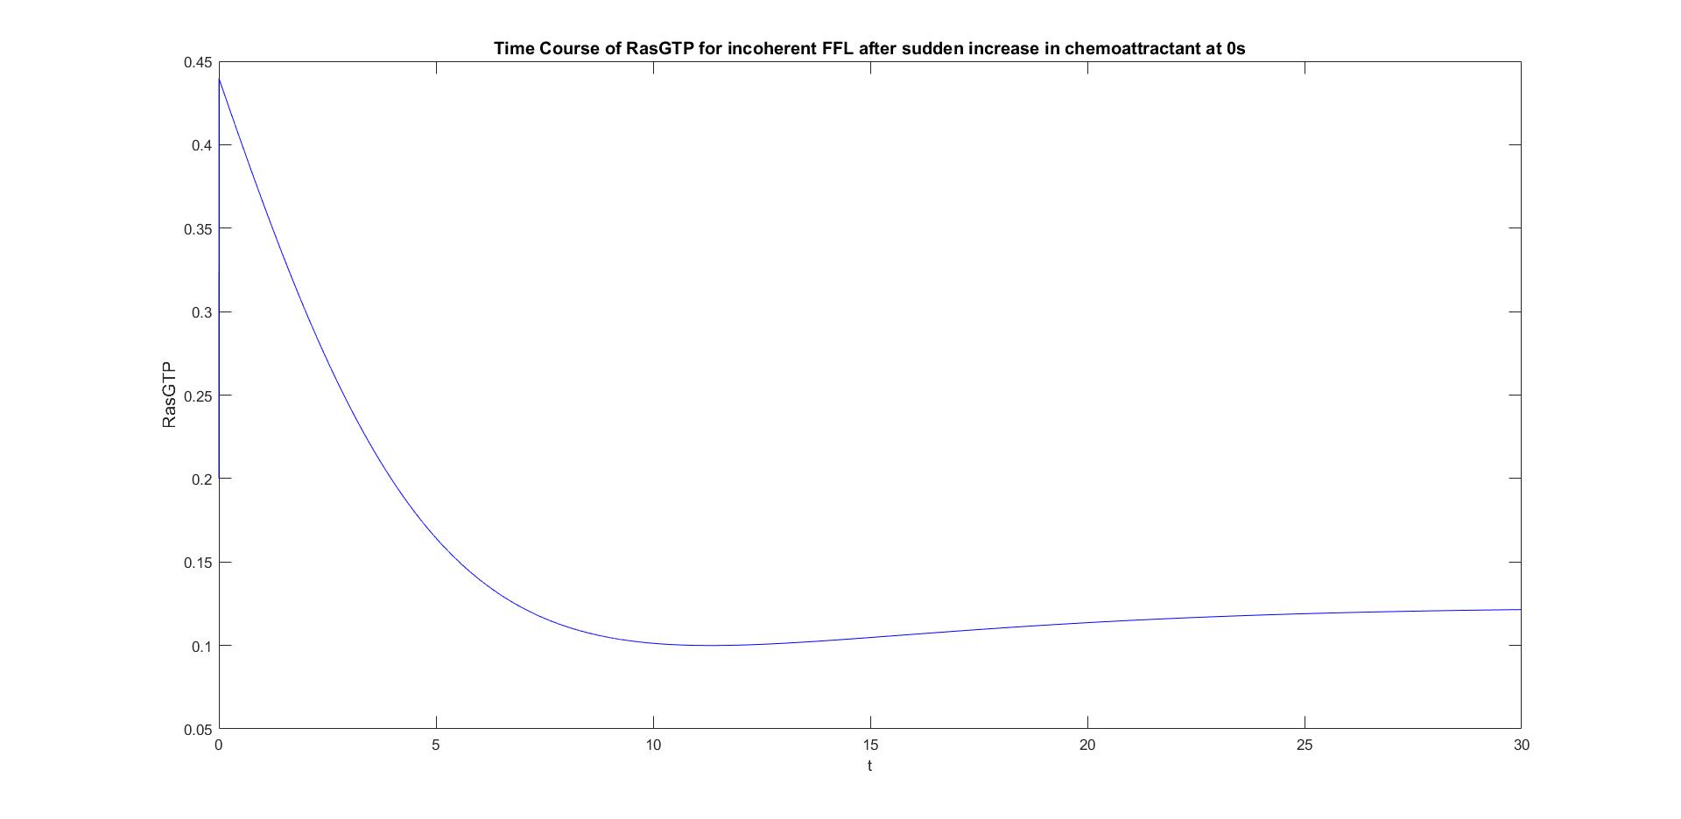

Slide 15
